Slide 1
Physics 4 – March 5, 2020
Do Now – Some missing notes
Objective:
  7.1 Radioactivity Lab
Assignment: (pending)
    Finish 7.1 Lab packet (due Tues next week)
    p283 #6-13 (Complete due Tues)
Agenda:
  Decay Reactions
  Radioactivity Lab:
    Part 1: Physical Pennies
    Part 2: Virtual Pennies
    Part 3: Simulation of Atoms
  Use Pennies in bag
  Use TI-84 calculator or website for virtual pennies
  Use Laptops from cart

Slide 2
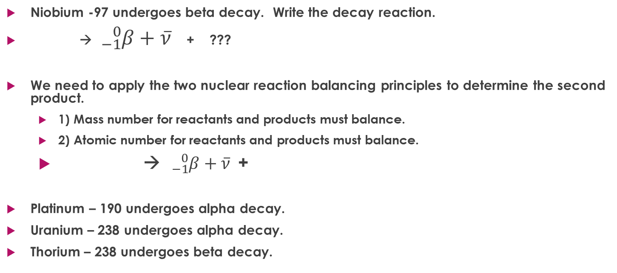
Reactions for nuclear decay
Niobium -97 undergoes beta decay. Write the decay reaction.
→ ${}_{−1}^{0}{β+\overline{ν}}$ + ???
We need to apply the two nuclear reaction balancing principles to determine the second product.
  1) Mass number for reactants and products must balance.
  2) Atomic number for reactants and products must balance.
  → ${}_{−1}^{0}{β+\overline{ν}}$+
Platinum – 190 undergoes alpha decay.
Uranium – 238 undergoes alpha decay.
Thorium – 238 undergoes beta decay.

Slide 3
Exit slip and homework
  Exit Slip – Clean up
  What’s due? (homework for a homework check next class)
    7.1 Lab packet
    p283 #6-13
  What’s next? (What to read to prepare for the next class)
    Read 7.1

